Slide 1



















Software Development using ISO/IEC 29110 TR – Engineering and Management Guide
Prepared by Alena Buchalcevova
Member of ISO/IEC JTC 1 SC7 - Working Group 24
Prague University of Economics, Czech Republic

Slide 2
Overview of the Course
This course uses an existing software development process for VSEs that is built according to ISO/IEC 29110 TR – Engineering and Management Guide (building this process is covered in the course 3 Development of a Software engineering Process using ISO/IEC 29110 TR – Engineering and Management Guide )
Software development process is used to develop a software component
Set of Deployment packages for the Generic Profile Group is used and evaluated

Slide 3
Content
Introduction
Specification of a sample project
Start of the project
Software requirements analysis
Software architectural and detailed design
Software construction
Software integration and tests
Product delivery
Evaluation of the process and deployment packages

Slide 4
Set of Documents Targeted by Audience
29110 Overview (TR 29110-1)
29110 ISPs
Framework and Taxonomy (ISP 29110-2)
Specifications of VSE Profiles (ISP 29110-4)
Specification - Nnnn VSE Profile
(ISP 29110-4-x)
29110 Guides (TR)
Assessment Guide (TR 29110-3)
Management and Engineering Guide (TR 29110-5)
Management and Engineering Guide – Nnnn
VSE Profile
(TR 29110-5-x)
Source: ISO/IEC 29110

Slide 5
Set of Documents Targeted by Audience
General Documents (applicable to all Profiles)
  Part 1- Overview (Technical Report)
    Introduces the major concepts required to understand and use the suite of documents
  Part 2- Framework and Profile Taxonomy (Standard)
    Specifies the elements common to all profiles (structure, conformance, assessment) and introduces the taxonomy (catalogue) of 29110 profiles.
  Part 3 -Assessment Guide (Technical Report)
    Describes the process to follow to perform an assessment to determinate the process capabilities and the organizational process maturity
Documents for the first Profile (specific to one Profile)
  Part 4-1-x -Specifications (Standard)
    Provides the composition of a profile, provide normative links to the normative subset of standards
  Part 5-1-x Management and Engineering Guide (Technical Report)
    Provide guidance on its implementation and use of a profile
      Deployment Packages (DP)

Slide 6
Basic Profile
Rationale of the Basic Profile
  To define a software development and project management guide for a subset of processes and outcomes of ISO/IEC 12207 and ISO/IEC 15289 products, appropriate for characteristics and needs of VSEs.
    The reason to include project management is that VSEs’ core business is software development and their financial success depends on project profits.
Applicability
  Describes software development of a single application by a single project team with no special risk or situational factors.
  The project may be to fulfil an external or internal contract.
The text is extracted from ISO/IEC 29110

Slide 7
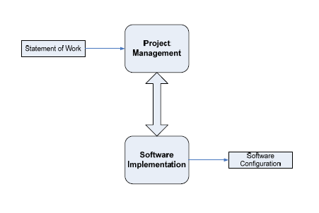
Basic Profile Guide Processes
PM process uses the customer’s statement of work to elaborate the project plan. The PM project assessment and control tasks compare the project progress against the project plan and actions are taken to eliminate deviations or incorporate changes to the project plan. The PM project closure activity delivers the software configuration, produced by SI, and gets the customer’s acceptance to formalize the end of the project. A project repository is established to save the work products and to control its versions during the project.
The execution of the SI process is driven by the project plan. SI process starts with an initiation activity of the project plan review. Project plan will guide the execution of the software requirements analysis, software architectural and detailed design, software construction, software integration and test, and product delivery activities
The text is extracted from ISO/IEC 29110

Slide 8
Terms and definitions
Process
  a set of interrelated or interacting activities which transforms inputs into outputs [ISO 9000:2005]
Activity
  a set of cohesive tasks of a process [ISO 12207:2008]
Task
  requirement, recommendation, or permissible action, intended to contribute to the achievement of one or more outcomes of a process [ISO/IEC 12207:2008]
Verification
  confirmation, through the provision of objective evidence, that specified requirements have been fulfilled [ISO 9000:2005]
  NOTE Verification in a life cycle context is a set of activities that compares a product of the life cycle against the required characteristics for that product. This may include, but is not limited to, specified requirements, design description and the system itself.
Validation
  confirmation, through the provision of objective evidence, that the requirements for a specific intended use or application have been fulfilled [ISO 9000:2005]
  NOTE Validation in a life cycle context is the set of activities ensuring and gaining confidence that a system is able to accomplish its intended use, goals and objectives.
The text is extracted from ISO/IEC 29110

Slide 9
Terms and definitions
Requirements analysis
  The process of studying user needs to arrive at a definition of system, hardware, or software requirements. [ISO/IEC 24765]
Requirements document
  a document containing any combination of recommendations, requirements or regulations to be met by a software package. [ISO/IEC 24765]
Requirements phase
  the period of time in the software life cycle during which the requirements for a software product are defined and documented. [ISO/IEC 24765]
The text is extracted from ISO/IEC 29110

Slide 10
Terms and definitions
Software Requirements Specifications
  The SRS is a specification for a particular software product, program, or set of programs that performs certain functions in a specific environment. The SRS may be written by one or more representatives of the supplier, one or more representatives of the customer, or by both. [IEEE830-98]
  The SRS document contains both functional and non functional requirements.
  The SRS can be materialized in a word document but it can also be managed in a database or in a Excel file.
The text is extracted from ISO/IEC 29110

Slide 11
Terms and definitions
Requirement
  1. a statement that identifies what a product or process must accomplish to produce required behaviour and/or results. IEEE 1220-2005 IEEE Standard for the Application and Management of the Systems Engineering Process. 3.1.16. 2. a system or software requirement that specifies a function that a system/software system or system/software component must be capable of performing. ISO/IEC 24765, Systems and Software Engineering Vocabulary. 3. a requirement that specifies a function that a system or system component must be able to perform. [ISO/IEC24765]
The text is extracted from ISO/IEC 29110

Slide 12
Terms and definitions
Non Functional Requirement
  a software requirement that describes not what the software will do but how the software will do it. ISO/IEC 24765, Systems and Software Engineering Vocabulary. Syn. design constraints, non-functional requirement. See also: functional requirement. NOTE for example, software performance requirements, software external interface requirements, software design constraints, and software quality attributes. Non functional requirements are sometimes difficult to test, so they are usually evaluated subjectively. [ISO/IEC24765]
Baseline
  a specification or product that has been formally reviewed and agreed upon, that thereafter serves as the basis for further development, and that can be changed only through formal change control procedures. [ISO/IEC 12207]
The text is extracted from ISO/IEC 29110

Slide 13
Terms and definitions
Prototype
  an experimental model, either functional or non functional, of the system or part of the system. IEEE 1233, 1998 Edition (R2002) IEEE Guide for Developing System Requirements Specifications. 3.12. 2. a preliminary type, form, or instance of a system that serves as a model for later stages or for the final, complete version of the system. ISO/IEC 24765, Systems and Software Engineering Vocabulary. 3. model or preliminary implementation of a piece of software suitable for the evaluation of system design, performance or production potential, or for the better understanding of the software requirements. ISO/IEC 15910:1999 Information technology -- Software user documentation process. 4.41. [ISO/IEC24765]
The text is extracted from ISO/IEC 29110

Slide 14
Terms and definitions
Traceable
  having components whose origin can be determined. [ISO/IEC24765]
Traceability matrix
  a matrix that records the relationship between two or more products of the development process. [ISO/IEC24765]

Slide 15
Project Management (PM) Process
Purpose
  To establish and carry out in a systematic way the tasks of the software implementation project, which allows complying with the project’s objectives in the expected quality, time and costs.
The text is extracted from ISO/IEC 29110

Slide 16
Project Management (PM) Process – 7 Objectives
PM.O1. The Project Plan for the execution of the project is developed according to the Statement of Work and validated with the Customer. The tasks and resources necessary to complete the work are sized and estimated.
PM.O2. Progress of the project is monitored against the Project Plan and recorded in the Progress Status Record.
PM.O3. The Change Requests are addressed through their reception and analysis. Changes to software requirements are evaluated for cost, schedule and technical impact.
PM.O4. Review meetings with the Work Team and the Customer are held. Agreements are registered and tracked.
PM.O5. Risks are identified as they develop and during the conduct of the project.
PM.O6. A software Version Control Strategy is developed. Items of Software Configuration are identified, defined and baselined. Modifications and releases of the items are controlled and made available to the Customer and Work Team including the storage, handling and delivery of the items
PM.O7. Software Quality Assurance is performed to provide assurance that work products and processes comply with the Project Plan and Requirements Specification.
The text is extracted from ISO/IEC 29110

Slide 17
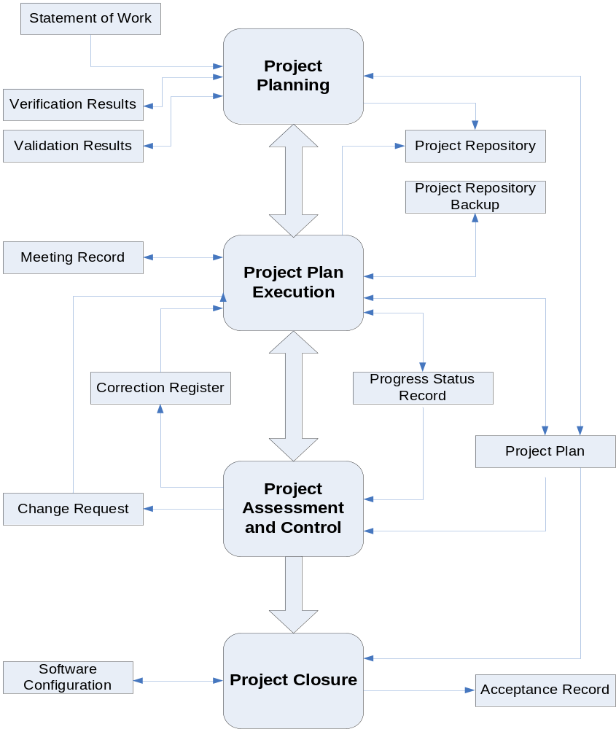
Project Management Process – 5 Activities
Extracted from ISO/IEC 29110

Slide 18
Software Implementation (SI) Process
The purpose of the Software Implementation process is the systematic performance of the analysis, design, construction, integration and tests activities for new or modified software products according to the specific requirements

Slide 19
Software Implementation (SI) Process – 7 Objectives
Objectives
  SI.O1. Tasks of the activities are performed through the accomplishment of the current Project Plan.
  SI.O2. Software requirements are defined, analyzed for correctness and testability, approved by the Customer, baselined and communicated.
  SI.O3. Software architectural and detailed design is developed and baselined. It describes the software items and internal and external interfaces of them. Consistency and traceability to software requirements are established.
  SI.O4. Software components defined by the design are produced. Unit test are defined and performed to verify the consistency with requirements and the design. Traceability to the requirements and design are established.
  SI.O5. Software is produced performing integration of software components and verified using Test Cases and Test Procedures. Results are recorded at the Test Report. Defects are corrected and consistency and traceability to Software Design are established.
  SI.O6. A Software Configuration, that meets the Requirements Specification as agreed to with the Customer, which includes user, operation and maintenance documentations is integrated, baselined and stored at the Project Repository. Needs for changes to the Software Configuration are detected and related Change Requests are initiated.
  SI.O7. Verification and Validation tasks of all required work products are performed using the defined criteria to achieve consistency among output and input products in each activity. Defects are identified, and corrected; records are stored in the Verification/Validation Results.
The text is extracted from ISO/IEC 29110

Slide 20
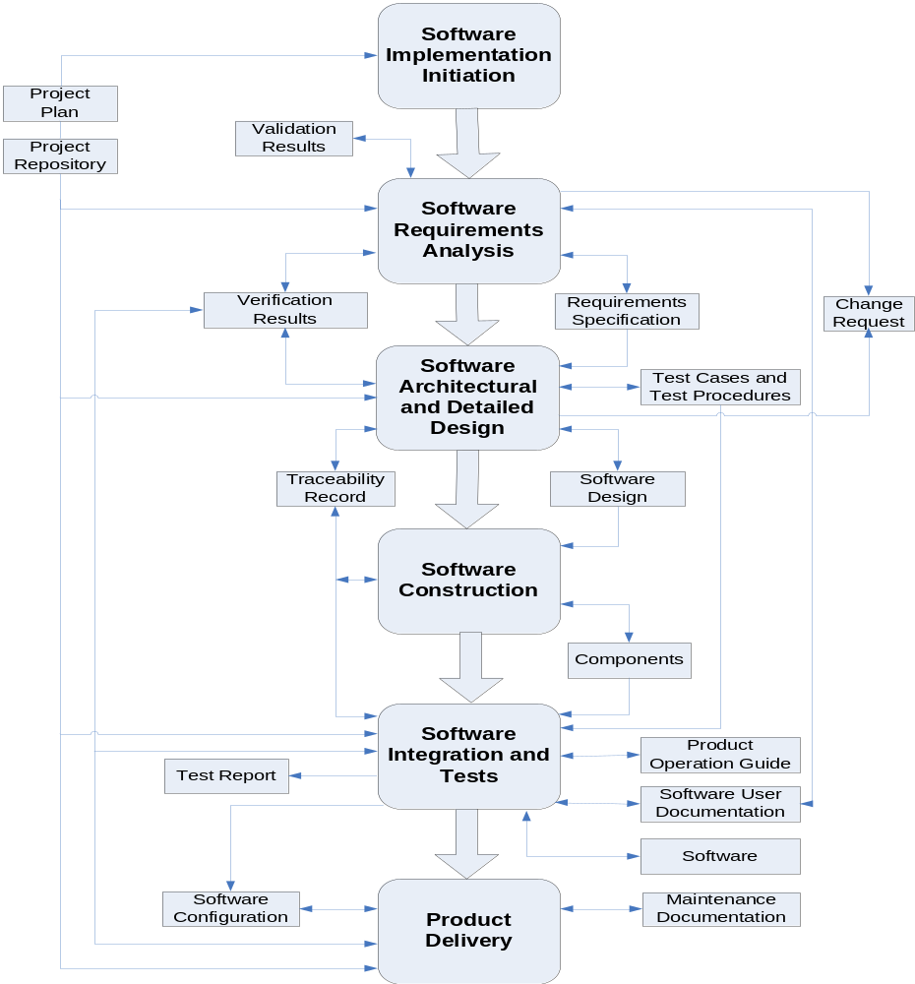
Software Implementation – 6 Activities
Extracted from ISO/IEC 29110

Slide 21
Deployment Packages (DPs)
A deployment package is a set of artifacts developed to facilitate the implementation of a set of practices, of the selected framework, in a VSE.
  A deployment package is not a complete process reference model. Deployment packages are not intended to preclude or discourage the use of additional guidelines that VSEs find useful.
By deploying and implementing a Deployment Package, a VSE can see its concrete step to achieve or demonstrate coverage to Part 5 *.
Deployment Packages are designed such that a VSE can implement its content, without having to implement the complete framework at the same time.
Each DP is reviewed and edited by 2 persons
  Ana Vasquez (Mexico)
  Claude Y Laporte (Canada)
* And coverage to other standards and Models

Slide 22


Deployment Packages for the Basic Profile
Verification
and
Validation
Construction
Tests
Architecture
and
Detailed Design
Product
Delivery
Project
Management
Version
Control
Requirements
Analysis
Self-Assessment
Deployment Packages are free !

Slide 23
Content
Introduction
Specification of a sample project
Start of the project
Software requirements analysis
Software architectural and detailed design
Software construction
Software integration and tests
Product delivery
Evaluation of the process and deployment packages

Slide 24
Specification of a sample project
Example of a sample project
Training centre IS
TrainPeople is a small company providing training in the field of informatics. Company is planning to develop a new web-enabled system. The new system allows customers to register for courses on Internet, lectors to display their courses and managers to control the education process.
Courses are of various types according to a level (basic, advanced, certified), length and place (rooms in the TrainPeople’s building or at the customer’s place). Unregistered customer can display list of courses and detail description of each course. To enroll for a course customer has to register to the system. Lectors are recorded in the system with information about courses they can teach. Lectors enter their time availability and a course manager assigns lectors to concrete course runs. Lectors can display list of participants and record evaluation of each participant. Participants can fill in evaluation of a course they have attended.

Slide 25
Content
Introduction
Specification of a sample project
Start of the project
Software requirements analysis
Software architectural and detailed design
Software construction
Software integration and tests
Product delivery
Evaluation of the process and deployment packages

Slide 26
Project Management (PM) Process
Input products
  Products required to perform the process and its corresponding source, which can be another process or an external entity to the project, such as the Customer.
Name | Source
Statement of Work | Customer
Software Configuration | Software Implementation
Change Request | Customer Software Implementation
The text is extracted from ISO/IEC 29110

Slide 27
Project Management (PM) Process
Output products
  Products generated by the process and its corresponding destination, which can be another process or an external entity to the project, such as Customer or Organizational Management.
Name | Destination
Project Plan | Software implementation
Acceptance Record | Organizational Management
Project Repository | Software implementation
Meeting Record | Customer
Software Configuration | Customer
The text is extracted from ISO/IEC 29110

Slide 28
Project Management (PM) Process
Internal products
  Products generated and consumed by the process.
Name
Change Request
Correction Register
Meeting Record
Verification Results
Validation Results
Progress Status Record
Project Repository Backup
The text is extracted from ISO/IEC 29110

Slide 29
Project Planning Activity
Provides:
  Reviewed Statement of Work and the tasks needed to provide the contract deliverables and to satisfy customer requirements.
  Project life cycle, including task dependencies and duration.
  Project quality assurance strategy through verification and validation of work products/deliverables, customer and work team reviews.
  Work team and customer roles and responsibilities.
  Project resources and training needs.
  Estimates of effort, cost and schedule.
  Identified project risks.
  Project version control and baseline strategy.
  Project repository to store, handle and deliver controlled product and document versions and baselines.
The text is extracted from ISO/IEC 29110

Slide 30
Roles assessment and teams building
Role | Abbreviation | Competency
Analyst | AN | Knowledge and experience eliciting, specifying and analyzing the requirements. Knowledge in designing user interfaces and ergonomic criteria. Knowledge of the revision techniques and experience on the software development and maintenance. Knowledge of the editing techniques and experience on the software development and maintenance.
Customer | CUS | Knowledge of the Customer processes and ability to explain the Customer requirements. The Customer (representative) must have the authority to approve the requirements and their changes. The Customer includes user representatives in order to ensure that the operational environment is addressed. Knowledge and experience in the application domain.
Designer | DES | Knowledge and experience in the software components and architecture design. Knowledge of the revision techniques and experience on the software development and maintenance. Knowledge of the editing techniques and experience on the software development and maintenance. Knowledge and experience in the planning and performance of integration and system tests.
Programmer | PR | Knowledge and/or experience in programming, integration and unit tests. Knowledge of the revision techniques and experience on the software development and maintenance. Knowledge of the editing techniques and experience on the software development and maintenance.
Project Manager | PM | Leadership capability with experience making decisions, planning, personnel management, delegation and supervision, finances and software development.
Technical Leader | TL | Knowledge and experience in the software development and maintenance.
Work Team | WT | Knowledge and experience according to their role.
The text is extracted from ISO/IEC 29110

Slide 31
Software Implementation initiation
The Software Implementation Initiation activity ensures that the Project Plan established in Project Planning activity is committed to by the Work Team.
  Review of the Project Plan by the Work Team to determine task assignment.
  Commitment to Project Plan by the Work Team and Project Management.
  An implementation environment established.
The text is extracted from ISO/IEC 29110

Slide 32
Project Plan Execution activity
Provides:
  Agreement with the Project Manager (PM) and Technical Leader (TL) on the tasks assignments.
  Progress Status Record of the project updated.
  Analyzed and evaluated change requests to the plan impacting cost, schedule and technical requirements.
  Approved changes to the plan
  Reviews and agreements with the Work Team (WT) and Customer (CUS).
  Back up of the Project Repository, and its recovery if necessary.

Slide 33
Project Assessment and Control activity
Provides:
  Reviews of actual plan performance and progress against targets.
  Identified and evaluated significant cost, schedule and technical performance deviations and problems.
  Review of project risks and identification of new risks.
  Documented change requests, appropriate corrective action defined, and changes tracked to closure.

Slide 34
Content
Introduction
Specification of a sample project
Start of the project
Software requirements analysis
Software architectural and detailed design
Software construction
Software integration and tests
Product delivery
Evaluation of the process and deployment packages

Slide 35
Software Requirements Analysis
The Software Requirements Analysis activity analyzes the agreed customer’s requirements and establishes the validated project requirements. The activity provides:
  Elicitation, analysis and specification of customer’s requirements
  Agreement on the customer requirements.
  Verification and validation of requirements.
  Version control of the software requirements products.
The text is extracted from ISO/IEC 29110

Slide 36
Tasks of Software Requirements Analysis activity
Role | Task | Input Products | Output Products
TL AN | SI.2.1 Assign tasks to the Work Team members in accordance with their role, based on the current Project Plan. | Project Plan
AN CUS | SI.2.2 Document or update the Requirements Specification. Identify and consult information sources (customer, users, previous systems, documents etc.) in order to get new requirements. Analyze the identified requirements to determinate the scope and feasibility. Generate or update the Requirements Specification. | Product Description | Requirements Specification
The text is extracted from ISO/IEC 29110

Slide 37
Tasks of Software Requirements Analysis activity
Role | Task | Input Products | Output Products
AN | SI.2.3 Verification of the Requirements Specification. Verify the correctness and testability of the Requirements Specification and its consistency with the Product Description. Additionally, review that requirements are complete, unambiguous and not contradictory. .The results found are documented in a Verification Results and corrections are made until the document is approved by AN. If significant changes were needed, initiate a Change Request. | Requirements Specification Project Plan (Product Description) | Verification Results Requirements Specification [verified] Change Request [initiated]
CUS AN | SI.2.4 Validation of the Requirements Specification. Validate that Requirements Specification satisfies needs and agreed upon expectations, including the user interface usability. Defects found are documented in a Validation Results. The results found are documented in a Validation Results and corrections are made until the document is approved by CUS. | Requirements Specification [verified] | Validation Results Requirements Specification [validated]
The text is extracted from ISO/IEC 29110

Slide 38
Tasks of Software Requirements Analysis activity
Role | Task | Input Products | Output Products
AN | SI.2.5 Document the preliminary version of the Software User Documentation or update the present manual. (optional) | Requirements Specification [validated] | Software User Documentation [preliminary]
AN | SI.2.6 Verification of the Software User Documentation Verify consistency of the Software User Documentation with the Requirement Specification. .The results found are documented in a Verification Results and corrections are made until the document is approved by AN. If significant changes were needed, initiate a Change Request. (optional) | Software User Documentation [preliminary] Requirement Specification | Verification Results Software User Documentation [preliminary, verified] Change Request [initiated]
The text is extracted from ISO/IEC 29110

Slide 39
Tasks of Software Requirements Analysis activity
Role | Task | Input Products | Output Products
TL | SI.2.7 Incorporate the Requirements Specification, and *Software User Documentation to the Software Configuration in the baseline. *(optional) | Requirements Specification [validated] *Software User Documentation [preliminary, verified] | Software Configuration Requirements Specification [validated, baselined], * Software User Documentation [preliminary, verified,baselined]
The text is extracted from ISO/IEC 29110

Slide 40
Content
Introduction
Specification of a sample project
Start of the project
Software requirements analysis
Software architectural and detailed design
Software construction
Software integration and tests
Product delivery
Evaluation of the process and deployment packages

Slide 41
Software Architectural and Detailed Design
The Software Architectural and Detailed Design activity transforms the software requirements to the system software architecture and software detailed design.
The activity provides:
  Design software architecture, software components and associated interfaces.
  Detailed design of the components and interfaces.
  Work Team review of the Requirements Specification
  Software design verified and defects corrected.
  Verified Test Cases and Test Procedures for integration testing.
  Traceability of the software requirements to the software design, test cases, and test procedures.
  Design products and documents under version control.
The text is extracted from ISO/IEC 29110

Slide 42
Tasks of the Software Architectural and Detailed Design activity
SI.3.1 Assign tasks to the Work Team members related to their role according to the current Project Plan.
SI.3.2 Understand Requirements Specification.
SI.3.3 Document or update the Software Design
SI 3.4 Verification of the Software Design
SI.3.5 Establish or update Test Cases and Test Procedures for integration testing based on Requirements Specification and Software Design.
SI.3.6 Verification of the Test Cases and Test Procedures.
SI.3.7 Update the Traceability Record incorporating the Test Cases and Test Procedures.
SI.3.8 Incorporate the Software Design, Test Cases, Test Procedures and Traceability Record to the Software Configuration as part of the baseline.
The text is extracted from ISO/IEC 29110

Slide 43
SI.3.1. Assign tasks to the work team members related to their role, according to the current Project Plan
  Obtain requirement specifications from repository
  Obtain Test Cases and Test Procedures from repository
  Obtain Traceability Record from repository
  Use Requirement Specifications, Test Cases and Traceability Record to assign tasks.
The text is extracted from ISO/IEC 29110

Slide 44
SI 3.2. Understand Requirements Specification
Examine each requirements and be sure they are understood
  DES groups functional requirements in logical groups.
  DES groups non-functional requirements in groups.
  AN verify DES groups and checks if all requirements are understood.
If needed, update the Requirements Specifications to add necessary clarification.
  Store updated document in repository
The text is extracted from ISO/IEC 29110

Slide 45
SI.3.3 Document or update the Software Design
Analyze the Requirements Specification to generate the architectural design, its arrangement in subsystems and components defining the internal and external interfaces.
Describe in detail, the appearance and the behaviour of the interface, based on the Requirements Specification in a way that resources for its implementation can be foreseen.
Provide the detail of Components and their interfaces to allow the construction in an evident way.
Generate or update the Traceability Record.
  The traceability record should have been produced during the requirement analysis activities.
  Verify that every design element can be traced to a requirement
Verify that every requirement is represented in design
The text is extracted from ISO/IEC 29110

Slide 46
SI 3.4 Verification of the Software Design
Verify correctness of Software Design documentation, its feasibility and consistency with their Requirement Specification.
Verify that the Traceability Record contains the relationships between requirements and the Software Design elements.
Document the results in a Verification Results document.
Correct errors until the document is approved by AN. If significant changes were needed, initiate a Change Request.
The text is extracted from ISO/IEC 29110

Slide 47
SI.3.5 Establish or update Test Cases and Test Procedures for integration testing based on Requirements Specification and Software Design
Create Test Cases and Procedures document
If customer provides testing data, incorporate them in the document.
The text is extracted from ISO/IEC 29110

Slide 48
SI.3.6 Verification of the Test Cases and Test Procedures
Verify consistency among Requirements Specification, Software Design and Test Cases and Test Procedures.
Document the results found in a Verification Results
Correct errors until the document is approved by AN
The text is extracted from ISO/IEC 29110

Slide 49
SI.3.7 Update the Traceability Record incorporating the Test Cases and Test Procedures
Update the Traceability Record with the new test procedures.
Verify that every design and test element can be traced to a requirement
Verify that every requirement is represented in design
Verify that every requirement is represented in testing
The text is extracted from ISO/IEC 29110

Slide 50
SI.3.8 Incorporate the Software Design, Test Cases, Test Procedures and Traceability Record to the Software Configuration as part of the baseline
Store Software Design, Test Cases, Test Procedures and Traceability Record in the configuration management tool as described in the project software configuration policy.
The text is extracted from ISO/IEC 29110

Slide 51
Content
Introduction
Specification of a sample project
Start of the project
Software requirements analysis
Software architectural and detailed design
Software construction
Software integration and tests
Product delivery
Evaluation of the process and deployment packages

Slide 52
Software Construction activity
The Software Construction activity develops the software code and data from the Software Design. The activity provides:
  Work Team review of the Software Design to determine task assignment and software construction
  sequence.
  Coded software Components and applied unit tests.
  Traceability between Components and Software Design
The text is extracted from ISO/IEC 29110

Slide 53
Tasks of the Software Construction activity
Role | Task | Input Products | Output Products
TL | SI.4.1 Assign tasks to the Work Team members related to their role, according to the current Project Plan. | Project Plan
PR | SI.4.2 Understand Software Design | Software Design [verified,baselined]
PR | SI.4.3 Construct or update software Components based on the detailed part of the Software Design and define or update unit test cases. | Software Design [verified, baselined], Traceability Record [verified, baselined] | Components
PR | SI.4.4 Apply unit test cases to verify that functions work accordingly to the detailed part of the Software Design. | Components | Components [unit tested]
The text is extracted from ISO/IEC 29110

Slide 54
Tasks of the Software Construction activity
Role | Task | Input Products | Output Products
PR | SI.4.5 Correct the defects found until successful unit test (reaching exit criteria) is achieved. | Components [unit tested] | Components [corrected]
PR | SI.4.6 Update the Traceability Record incorporating Components constructed or modified. | Components [corrected] Traceability Record [verified,baselined]. | Traceability Record[updated]
TL | SI.4.7 Incorporate Components and Traceability Record to the Software Configuration as part of the baseline. | Components [corrected] Traceability Record [updated]Test Cases | Software Configuration Components [corrected,,baselined] Traceability Record [updated baselined] Test Cases and Test Procedures [verified, baselined]
The text is extracted from ISO/IEC 29110

Slide 55
Content
Introduction
Specification of a sample project
Start of the project
Software requirements analysis
Software architectural and detailed design
Software construction
Software integration and tests
Product delivery
Evaluation of the process and deployment packages

Slide 56
Software Integration and Tests
The Software Integration and Test activity ensures that the integrated software components satisfy the software requirements. The activity provides:
  Work Team review of the Project Plan to determine task assignment.
  Understanding of Test Cases and Procedures and the integration environment.
  Integrated components, corrected defects and documented results.
  Traceability of requirements and design to the integrated software product
  Documented and verified operational and software user documentations.
  Verified Software baseline
The text is extracted from ISO/IEC 29110

Slide 57
Tasks of the Software Integration and Tests activity
Role | Task | Input Products | Output Products
TL | SI.5.1 Assign tasks to the work team members related to their role, according to the current Project Plan. | Project Plan
PR | SI.5.2 Understand Test Cases and Test Procedures. Set or update the testing environment. | Test Cases and Test Procedures [verified,baselined]
PR | SI.5.3 Integrates the Software using Components and defines or updates Test Cases and Test Procedures for integration. | Components [corrected, baselined] Traceability Record [updated, baselined] | Software Test Cases and Test Procedures
The text is extracted from ISO/IEC 29110

Slide 58
Tasks of the Software Integration and Tests activity
Role | Task | Input Products | Output Products
TSTR CUS | SI.5.4 Perform tests using Test Cases and Test Procedures for integration and document results in Test Report. | Software Test Cases and Test Procedures | Software [tested] Test Report
PR | SI.5.5 Correct the defects found until successful test (reaching exit criteria) is achieved. | Software [tested], Test Report. | Software [corrected] Test Report [defects eliminated]
TSTR | SI.5.6 Updates the Traceability Record if appropriate. | Software [corrected] Traceability Record [verified,baselined]. | Traceability Record[updated]
The text is extracted from ISO/IEC 29110

Slide 59
Tasks of the Software Integration and Tests activity
Role | Task | Input Products | Output Products
PR | SI.5.7 Document the Product Operation Guide or update the current guide, if appropriate. | Software[tested] | Product Operation Guide
PR CUS | SI.5.8 Verification of the Product Operation Guide , if appropriate (see SI.5.7) Verify consistency of the Product Operation Guide with the Software. The results found are documented in a Verification Results and corrections are made until the document is approved by PR. | Product Operation Guide Software[tested] | Verification Results Product Operation Guide[verified]
AN | SI.5.9 Document the Software User Documentation or update the current one, if appropriate. | Software[tested] Software User Documentation [preliminary] (optional) | Software User Documentation
The text is extracted from ISO/IEC 29110

Slide 60
Tasks of the Software Integration and Tests activity
Role | Task | Input Products | Output Products
AN CUS | SI.5.10 Verification of the Software User Documentation, if appropriate (see SI.5.9) Verify consistency of the Software User Documentation with the Software. The results found are documented in a Verification Results and corrections are made until the document is approved by AN. | Software User Documentation Software[tested] | Verification Results Software User Documentation[verified]
TL | SI.5.11 Incorporate the Software, Traceability Record, Test Report, Product Operation Guide and Software User Documentation to the Software Configuration as part of the baseline. | Software [tested] Test Report Traceability Record[updated] Product Operation Guide[verified] Software User Documentation[verified] | Software Configuration Software[tested, baselined] Traceability Record[updated, baselined] Test Report [baselined] Product Operation Guide [verified, baselined] Software User Documentation [verified, baselined]
The text is extracted from ISO/IEC 29110

Slide 61
Content
Introduction
Specification of a sample project
Start of the project
Software requirements analysis
Software architectural and detailed design
Software construction
Software integration and tests
Product delivery
Evaluation of the process and deployment packages

Slide 62
Product Delivery
The Product Delivery activity provides the integrated software product to the Customer. The activity provides:
  Verified maintenance documentation
  Delivery of the software product and applicable documentation in accordance with the Delivery Instructions.

Slide 63
Tasks of the Product Delivery activity
Role | Task | Input Products | Output Products
TL | SI.6.1 Assign tasks to the work team members related to their role, according to the current Project Plan. | Project Plan
DES | SI.6.2 Understand Software Configuration. | Software Configuration
DES | SI.6.3 Document the Maintenance Documentation or update the current one. | Software Configuration | Maintenance Documentation
DES | SI.6.4 Verification of the Maintenance Documentation. Verify consistency of Maintenance Documentation with Software Configuration. The results found are documented in a Verification Results and corrections are made until the document is approved by DES. | Maintenance Documentation Software Configuration | Verification Results Maintenance Documentation [verified]

Slide 64
Tasks of the Product Delivery activity
Role | Task | Input Products | Output Products
TL | SI.6.5 Incorporate the Maintenance Documentation as baseline for the Software Configuration. | Software Configuration Maintenance Documentation [verified] | Software Configuration Maintenance Documentation[verified, baselined]
TL | SI.6.5 Perform delivery according to Delivery Instructions. | Delivery Instructions Software Configuration | Software Configuration [delivered]

Slide 65
Project Closure activity
Provides:
  Delivery of the product as specified in the Delivery Instructions.
  Support of Customer product acceptance in accordance to Delivery Instructions.
  Completion of the project and sign of the Acceptance Record.

Slide 66
Content
Introduction
Specification of a sample project
Start of the project
Software requirements analysis
Software architectural and detailed design
Software construction
Software integration and tests
Product delivery
Evaluation of the process and deployment packages

Slide 67
Bibliography
Rogers, Everett M., Diffusion of Innovations, fifth edition, Free Press, New York, 2003.
ISO/IEC JTC1/SC7 N3288, New Work Item Proposal – Software Life Cycles for Very Small Enterprises, May 2005. http://www.jtc1-sc7.org/.
ISO/IEC 29110 - Lifecycle Profiles for Very Small Entities (VSEs) – Part 1: Overview. International Organization for Standardization/International Electrotechnical Commission: Geneva, Switzerland.
ISO/IEC 15289 Systems and software engineering - Content of systems and software life cycle process information products (Documentation)
ISO/IEC 20000- Information Technology — Service Management, International Organization for Standardization/International Electrotechnical Commission: Geneva Switzerland.
Laporte, C.Y., Alexandre, S., O’Connor, R., A Software Engineering Lifecycle Standard for Very Small Enterprises, in R.V. O’Connor et al. (Eds.): EuroSPI 2008, CCIS 16, pp. 129–141.

